Slide 1
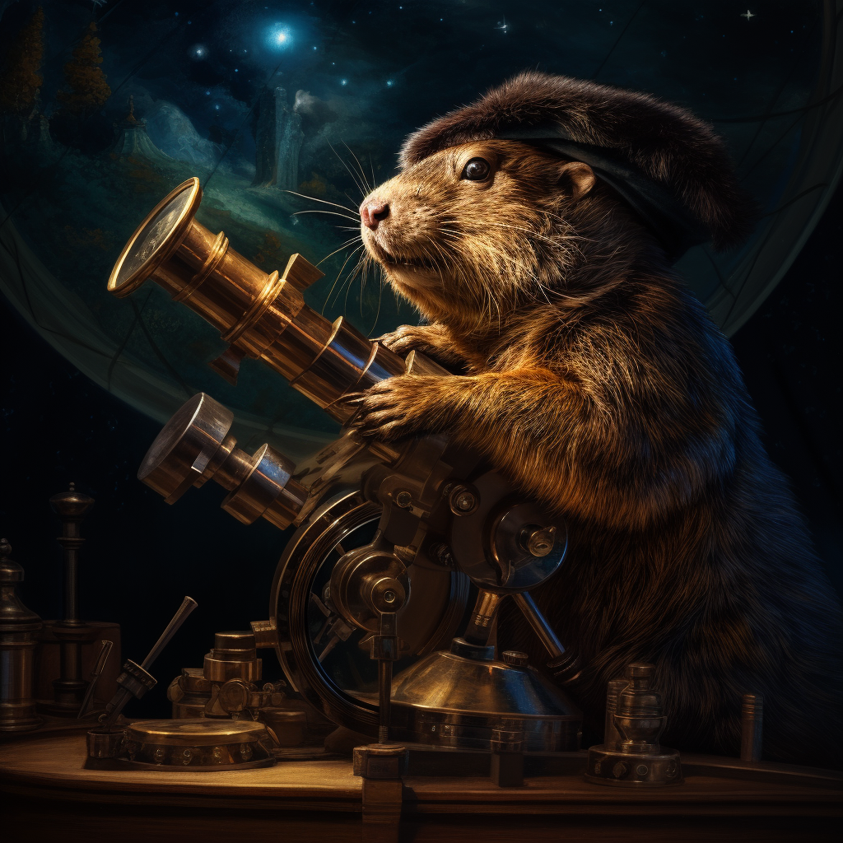

If Kepler had a computer
Python simulation of the solar system
Brescia, 11/12/2023

Slide 2
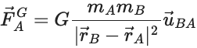
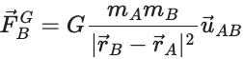
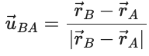
Let’s start simple
In the two-body problem, we want to simulate the dynamics of two objects interacting through gravitational force:

Slide 3
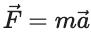
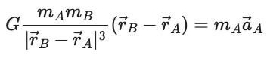
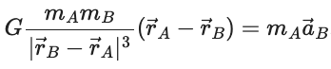
From Newton to Newton
Thanks to the 2nd law of motion , we can equate the forces:

Slide 4
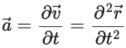
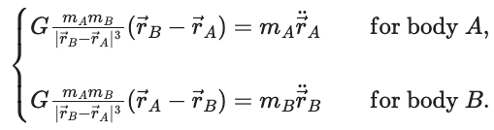
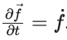
Differential equations 101
We have a system of differential equations! Indeed, so that we can re-write
These are 6 (second-order) Ordinary Differential Equations.

Slide 5
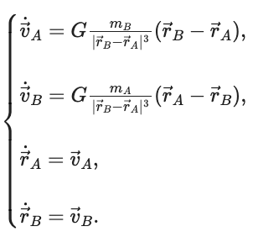
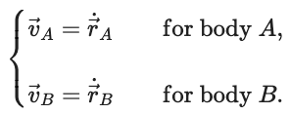
A common trick
We can lower the system’s order to 1 to make it easier to solve.
The trade-off is we get more equations in the system:

Slide 6
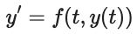
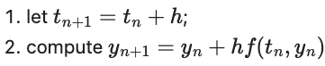
Numerical solving with Euler
Any first-order ODE system like can be simulated with the Euler method, i.e. iterating the following:

Slide 7
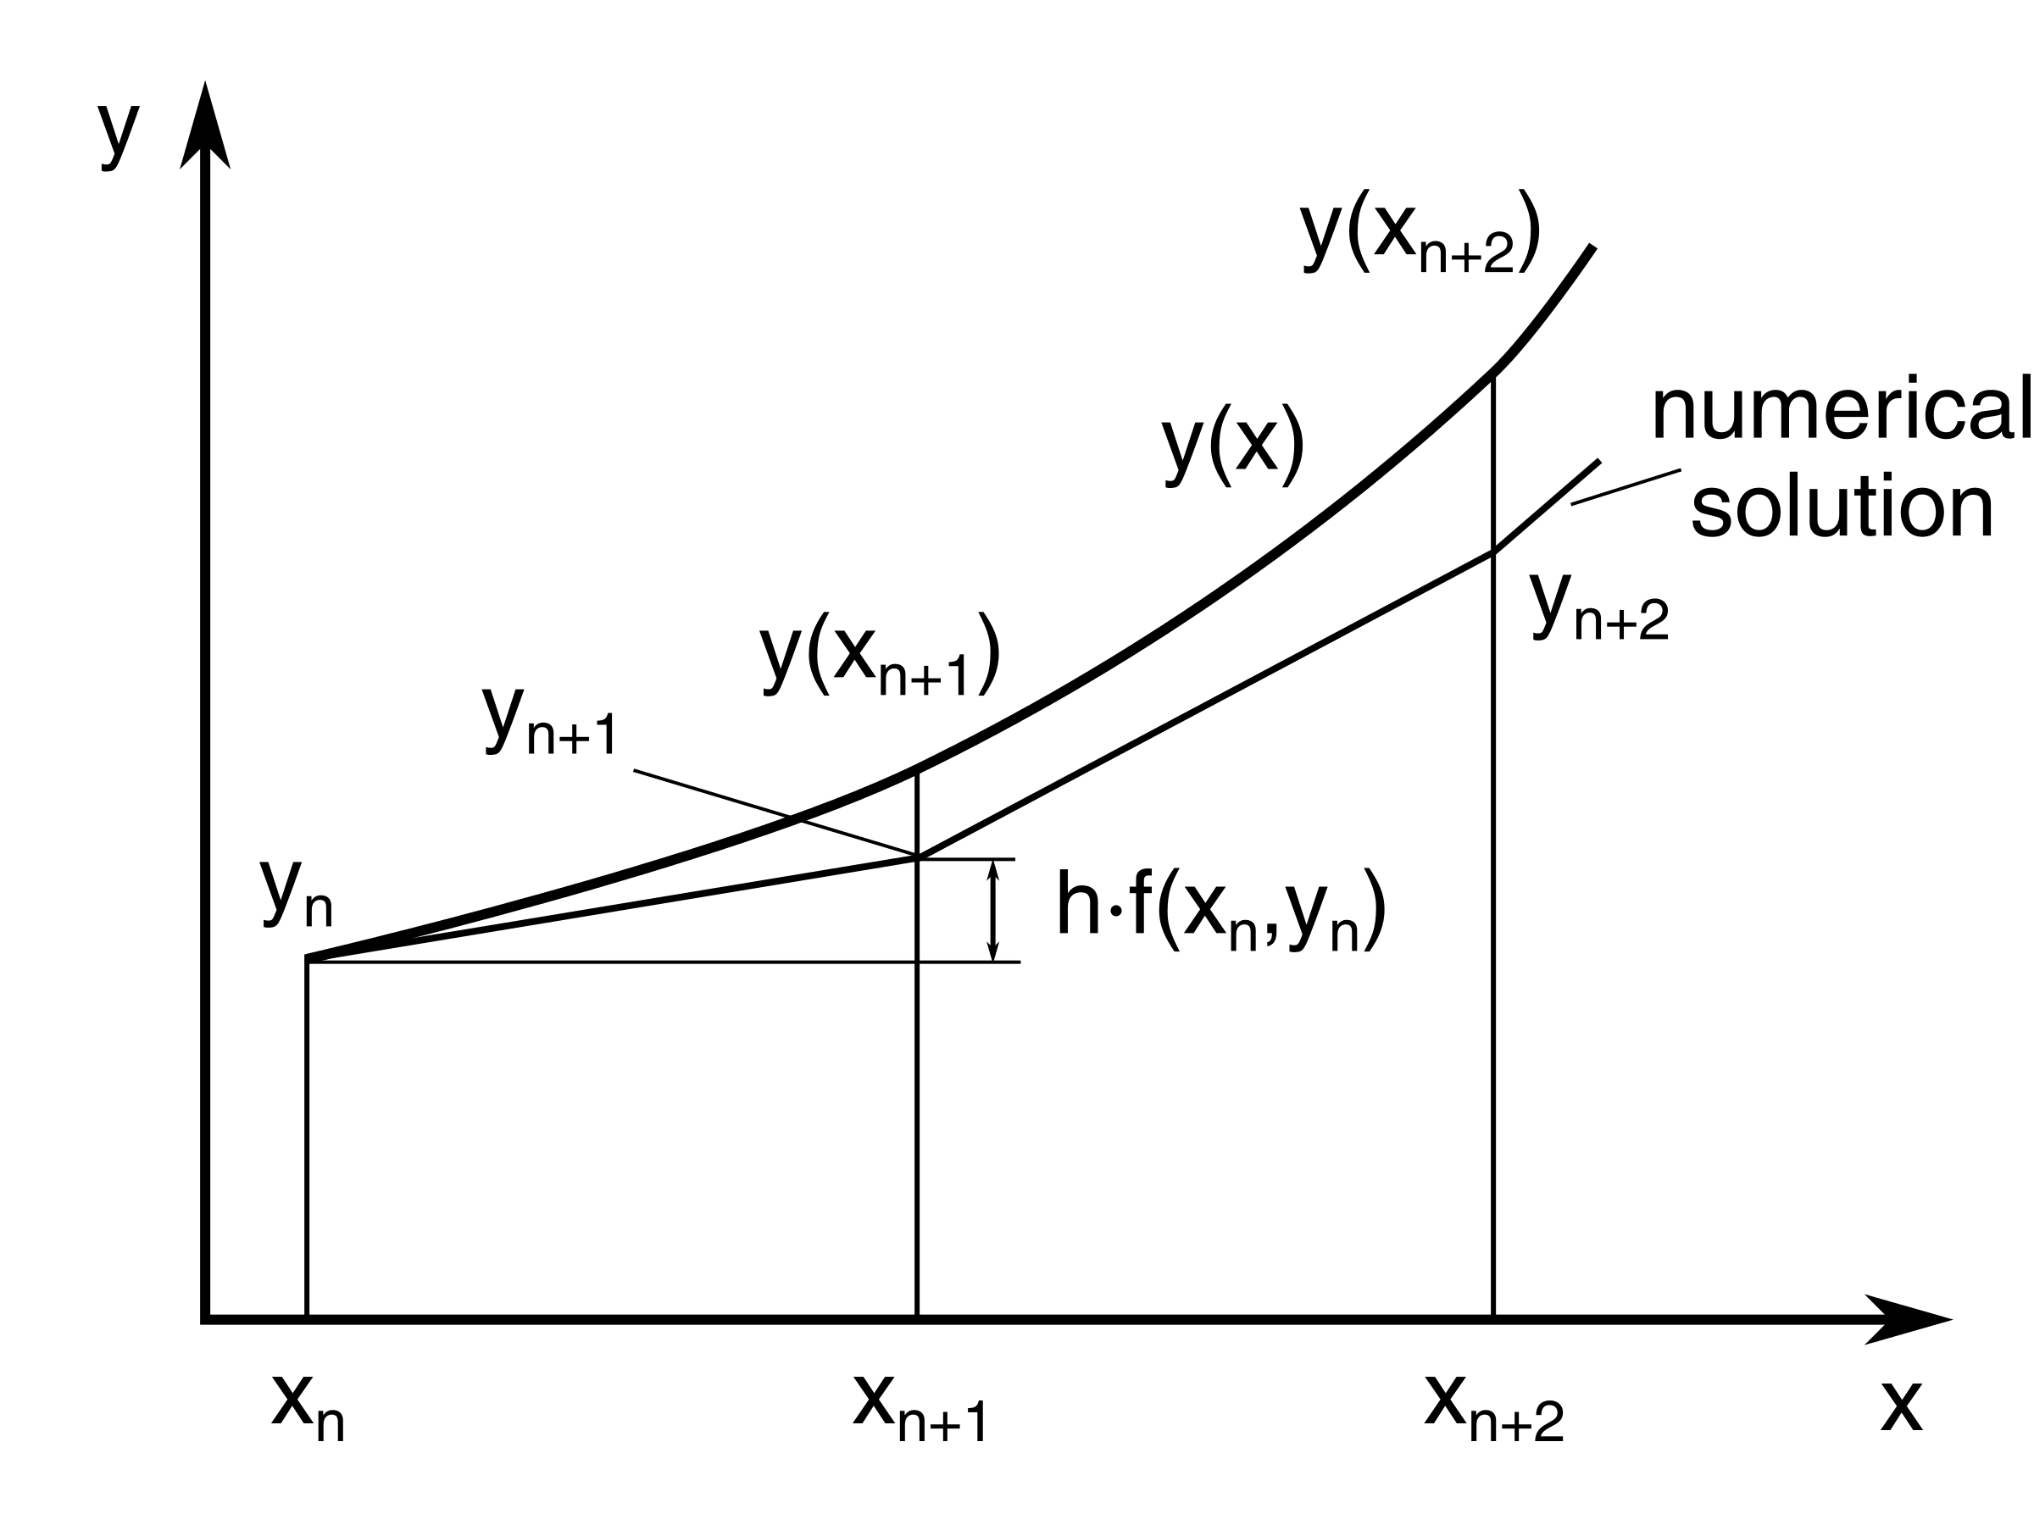
Why does it work?
It creates a piece-wise linear reconstruction of the solution by approximating its derivative to the first order.

Slide 8

DEMO TIME

Slide 9

About xtream
Visit https://xtreamers.io/!
Follow our LinkedIn page to learn about open positions.
Follow our Head of AI Emanuele Fabbiani.
Connect with our Data Scientist Gabriele Orlandi and our AI Engineer Fabio Lipreri.

Slide 10

Some Useful Resources
Resources
kepler
Enlightening Articles
Simulate a tiny solar system with Python
The two-body problem in Python
Numerical simulation of the planetary motions in the solar system...

